Slide 1
Firewall Implementation and TCP/IP Network Monitoring

Slide 2
Introduction
A firewall on router R1 using Ubuntu and iptables.
Packet filtering rules to control ICMP and TCP traffic based on instructions.
DNAT rules to redirect FTP and Telnet traffic to specific IPs.
Configured 3 routers (R1, R2, R3) based on the modified topology from Activity #2.

Slide 3
Script Execution on R1, R2, R3
R1 Script (firewall):
Configures all interfaces.
Enables IP forwarding.
R2 Script:
Sets interface IPs.
Adds static routes to reach LANs and servers.
R3 Script:
Configures uplink interface and routes to servers.
**fOR THIS PART GETBACK TO THE PREV GITHUB REPO: https://github.com/Hondanx/for_psd844 **

Slide 4
Initial Firewall Setup
1. Allow localhost (loopback) This ensures local services can communicate with each other:
iptables -A INPUT -i lo -j ACCEPT
iptables -A OUTPUT -o lo -j ACCEPT
2. Allow existing connections (stateful) Keeps replies flowing for allowed outbound connections:
iptables -A INPUT -m conntrack --ctstate ESTABLISHED,RELATED -j ACCEPT
iptables -A FORWARD -m conntrack --ctstate ESTABLISHED,RELATED -j ACCEPT
3. Set default policy to DROP This blocks everything unless explicitly allowed:
iptables -P INPUT DROP
iptables -P FORWARD DROP
iptables -P OUTPUT ACCEPT

Slide 5
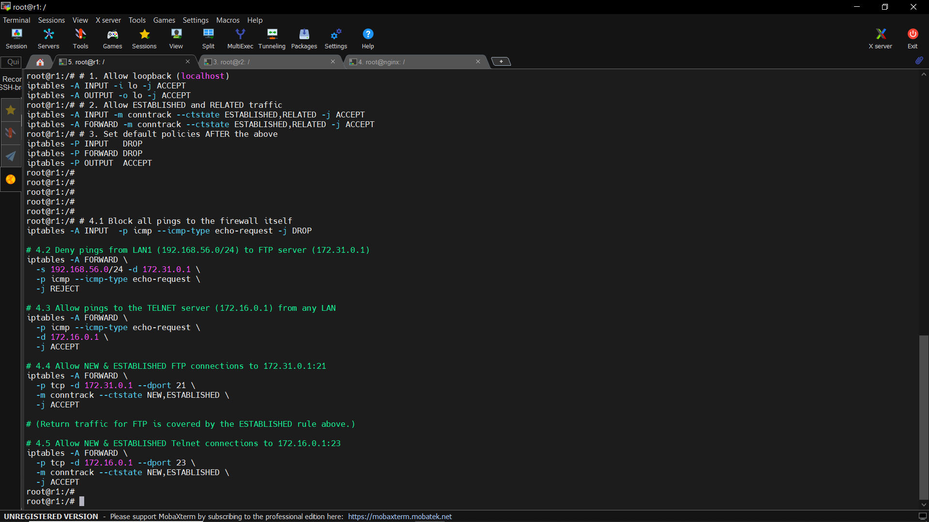

Slide 6
Blocking Pings (ICMP Filtering)
4.1 Block pings to firewall itself Avoids attacks or scans on the router:
iptables -A INPUT -p icmp --icmp-type echo-request -j DROP
4.2 Block LAN pings to FTP server (172.31.0.1) This prevents users in 192.168.56.0/24 from pinging the FTP server:
iptables -A FORWARD -s 192.168.56.0/24 -d 172.31.0.1 -p icmp --icmp-type echo-request -j REJECT
4.3 Allow pings to Telnet server (172.16.0.1) You allow diagnostics via ping for Telnet only:
iptables -A FORWARD -d 172.16.0.1 -p icmp --icmp-type echo-request -j ACCEPT

Slide 7
Allow FTP and Telnet Services
4.4 Allow FTP from LAN to 172.31.0.1:21 Allows new and ongoing FTP sessions:
iptables -A FORWARD -p tcp -d 172.31.0.1 --dport 21 -m conntrack --ctstate NEW,ESTABLISHED -j ACCEPT
4.5 Allow Telnet to 172.16.0.1:23 Same as above, for Telnet:
iptables -A FORWARD -p tcp -d 172.16.0.1 --dport 23 -m conntrack --ctstate NEW,ESTABLISHED -j ACCEPT
Why this works: Return traffic is allowed because we already enabled ESTABLISHED connections in step 2.

Slide 9
NAT with Port Forwarding
You used PREROUTING to redirect LAN traffic to real servers.
FTP control (port 21)
iptables -t nat -A PREROUTING -s 192.168.56.0/24 -p tcp --dport 21 -j DNAT --to-destination 172.31.0.1:21
FTP data (port 20)
iptables -t nat -A PREROUTING -s 192.168.56.0/24 -p tcp --dport 20 -j DNAT --to-destination 172.31.0.1:20
Telnet (port 23)
iptables -t nat -A PREROUTING -p tcp --dport 23 -j DNAT --to-destination 172.16.0.1:23
Purpose:
LAN users connect to public IP or gateway, but traffic gets redirected to internal IPs.
Users don't need to know real internal IPs — seamless redirection.

Slide 10
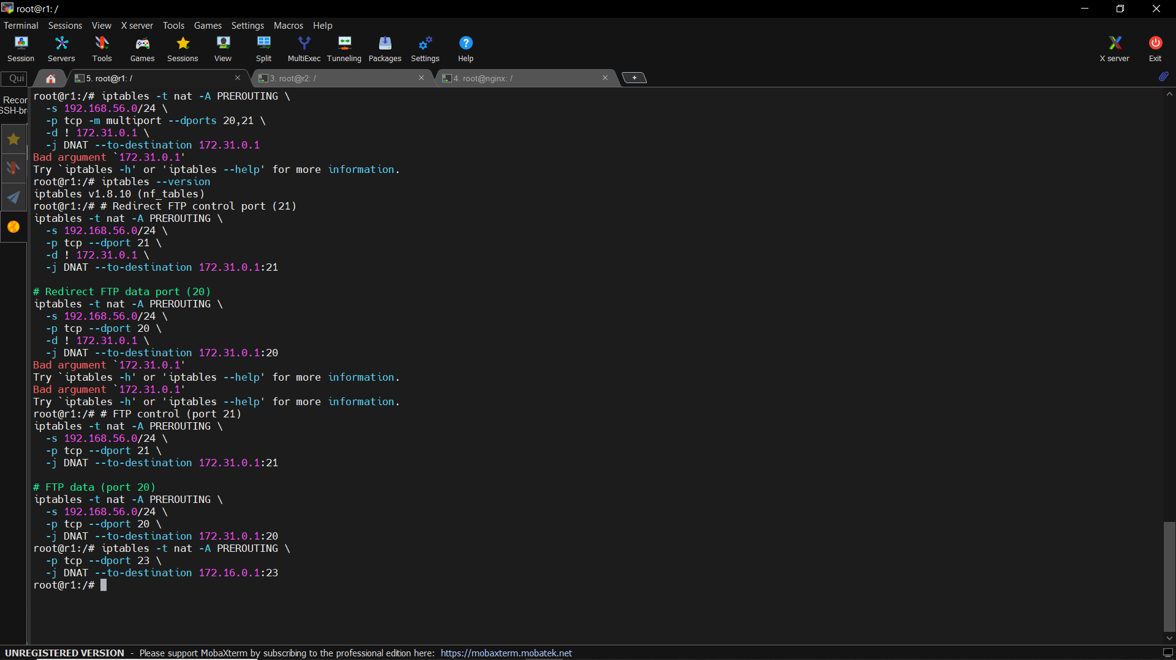

Slide 11
Verification with iptables -L -v -n
You listed rules with packet/byte counters:
iptables -L -v -n
What worked:
SSH (port 22) is open with many packets
FTP and Telnet rules show accepted packets
Ping from LAN to FTP server is blocked (confirmed by REJECT counter)
ICMP to Telnet allowed (packet match seen)

Slide 12
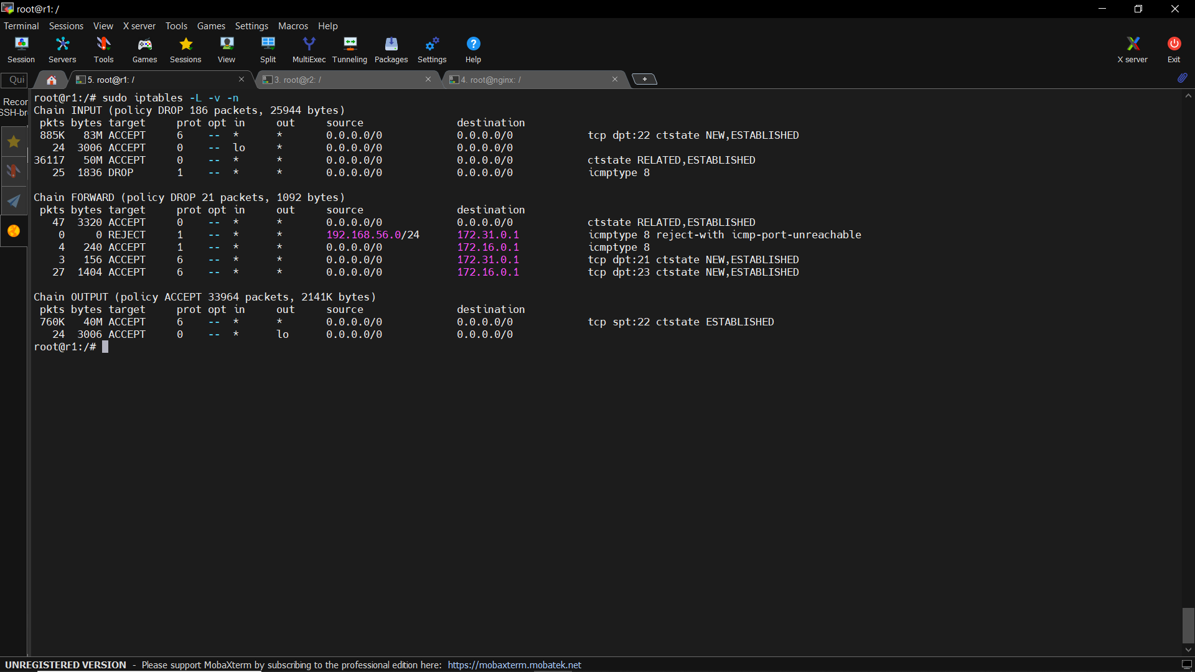

Slide 13
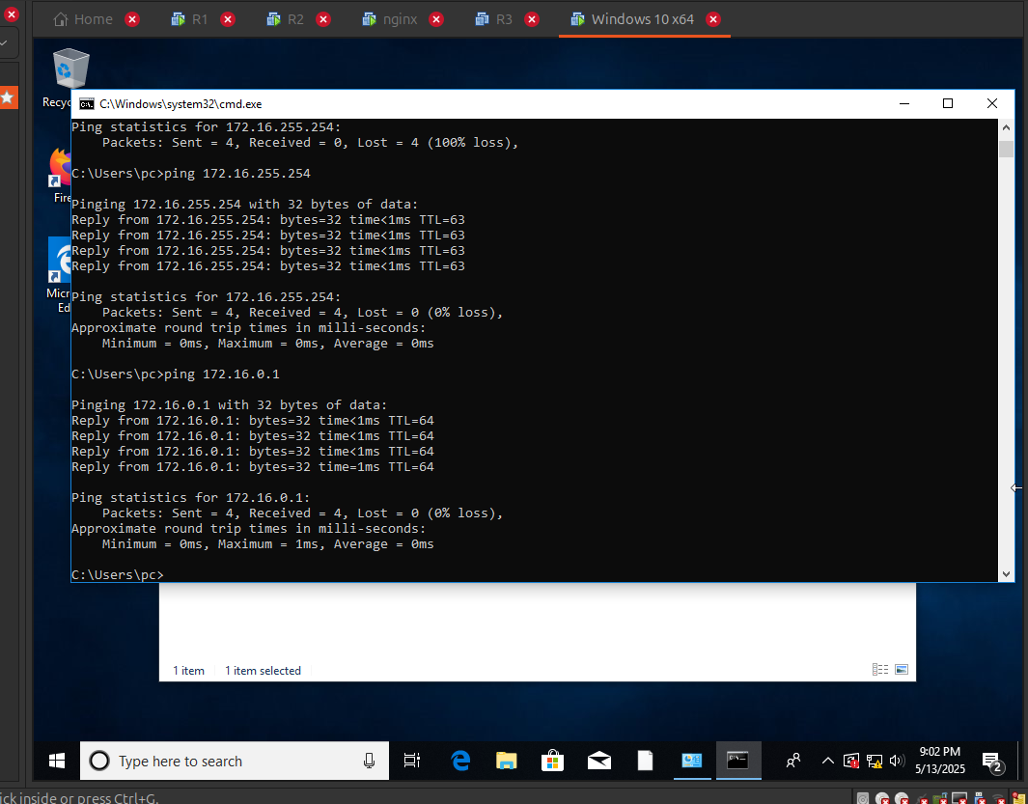
Ping Test Before Firewall Rules

Slide 14
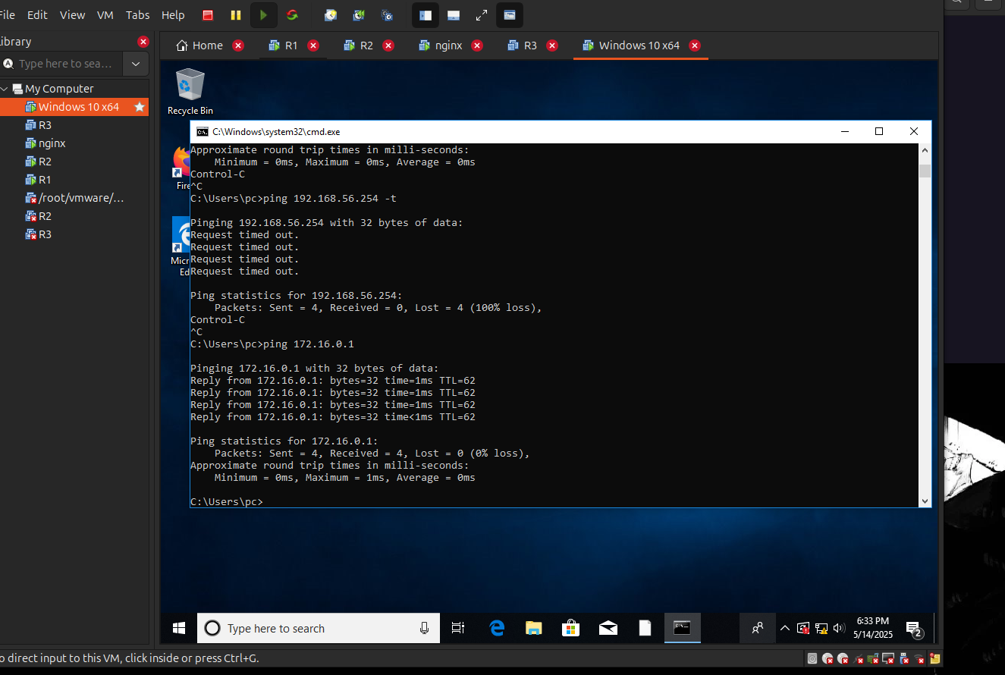
Ping Test After Firewall Rules

Slide 15
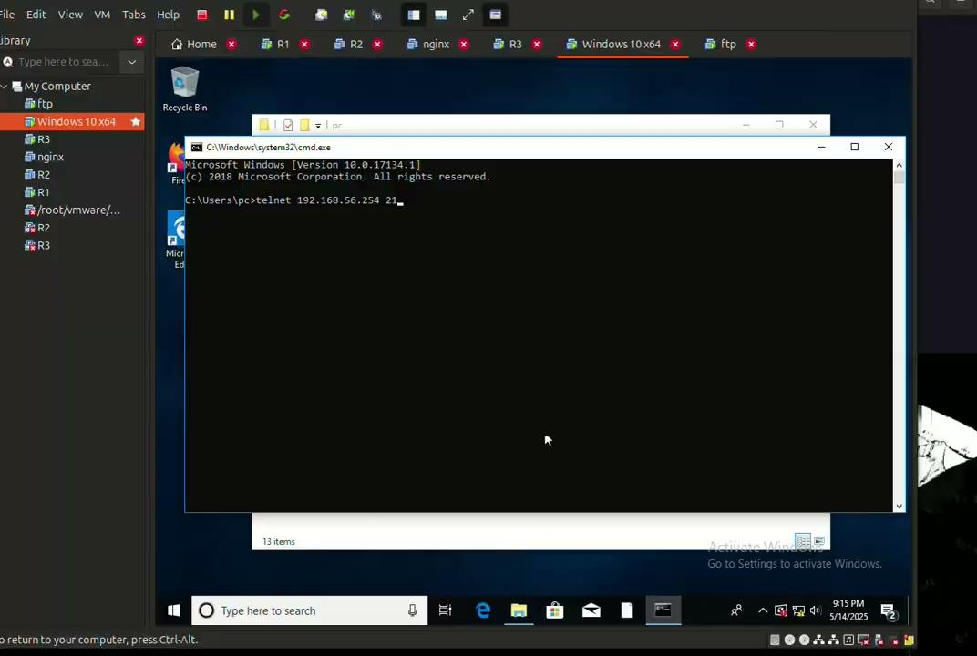
FTP NAT Test (With Screen Recording)

Slide 16
Thank you.

Slide 17
NAT with Port Forwarding

